Slide 1
Comprehensive Digital marketing
project for Amul
Team ID :LTVIP2024TMID10384
Team leader :Kottapalli Nandini
Team members :Makka jayachandrika
Nakka Meghana
Nasari Bhargavi
Nimmaka Usharani

Slide 2
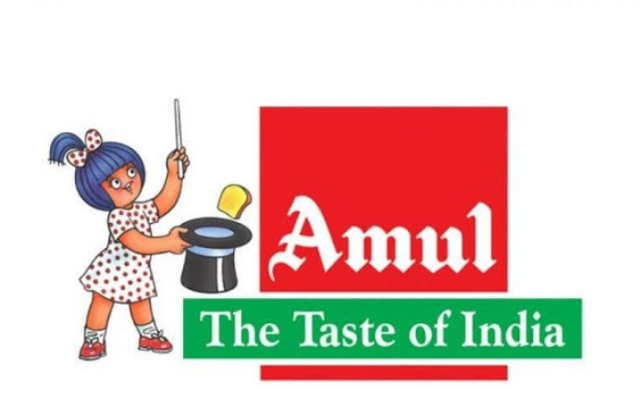
Brand Name : Amul

Slide 3
part 1 : Brand study ,Competitor Analysis & Buyers/ Audience persona

Slide 4

Brand study

Slide 5
Research Brand
Amul's success can be attributed to its cooperative structure, which ensures fair prices for farmers and efficient distribution of products. The brand has also been innovative in its marketing strategies, particularly through its popular "Amul Topical" advertisements. These advertisements are humorous and topical cartoons that appear on Amul's packaging and are widely shared across various media platforms.
Amul has received numerous awards and recognitions for its products and marketing strategies. The brand is committed to maintaining high-quality standards, sustainability, and social responsibility. Amul has been actively involved in rural development programs, women empowerment initiatives, and environmental conservation efforts.

Slide 6
mission/ values
1.Quality: Amul is committed to maintaining high-quality standards in its products and services, ensuring customer satisfaction.
2.Cooperative Spirit: As a cooperative organization, Amul believes in working together with its stakeholders, including farmers, employees, and customers, to achieve common goals.
3.Innovation: Amul continuously strives to innovate and improve its products, processes, and marketing strategies to meet the evolving needs of consumers.
4.Sustainability: Amul is dedicated to promoting sustainable practices in agriculture and the dairy industry, ensuring long-term growth and well-being for all involved.
5.Social Responsibility: Amul takes its role in society seriously and is committed to contributing to the development of rural communities, particularly those engaged in dairy farming.

Slide 7
USP of Amul
Quality products: Amul ensures the highest quality of its products by sourcing milk from over 3.6 million farmers across India, who follow strict hygiene and quality control practices.
Wide product range: Amul offers a diverse range of dairy products, including milk, butter, cheese, ghee, ice cream, and various other milk-based beverages and sweets. This caters to the diverse needs and preferences of Indian consumers.
Innovative marketing: Amul is known for its creative and humorous advertisements, often featuring the iconic Amul girl. These advertisements have become a part of Indian pop culture and have contributed to the brand's popularity.
Cooperative model: Amul operates as a cooperative, which means that it is owned and managed by the farmers who supply milk. This model ensures fair pricing for farmers and helps maintain the quality of the milk supply.
Affordability: Amul products are known for their reasonable prices, making them accessible to a wide range of consumers in India

Slide 8
Analyse Brand Tone and identity
Brand Tone : Amul's brand tone is often humorous, witty, and culturally relevant. They use clever wordplay, catchy slogans, and iconic advertisements featuring their mascot, the Amul girl, to engage with their audience while promoting their products, especially dairy items.
Brand identity: Amul's brand identity revolves around its association with quality, freshness, and the essence of Indian culture. It's known for its iconic logo featuring the Amul girl, who represents the spirit of India. The brand emphasizes its commitment to providing affordable, high-quality dairy products while maintaining a sense of humor and social relevance in its advertising campaigns. Additionally, Amul is recognized for its cooperative model, which empowers dairy farmers and promotes sustainability in the dairy industry.

Slide 9
Brand identity
Logo: The iconic Amul girl, also known as the Amul Lady, is the face of the brand. Designed by Eustace Fernandez in 1967, the Amul girl is a young, modern woman who exudes confidence and vitality. She is often depicted holding a tray with the brand's tagline, "The Taste of India," and a product-specific slogan.
Tagline: "The Taste of India" is Amul's tagline, which emphasizes the brand's commitment to providing quality dairy products that represent the diverse flavors of the country. This tagline has been in use since the 1960s and is instantly recognizable to consumers.
Co-operative spirit: Amul is a unique example of a successful dairy cooperative, owned by over 3.6 million milk producers. This cooperative model is reflected in the brand's identity, emphasizing the collective strength and unity of farmers.
Advertising: Amul is known for its witty and topical advertising campaigns. The brand regularly creates humorous and relevant advertisements that connect with the audience, often referencing current events or popular culture. These ads are known as "Amul Topical," and they have played a significant role in building the brand's image as approachable, relatable, and fun.
Packaging: Amul's packaging is designed to be visually appealing and easily recognizable.

Slide 10
Smart goals and kpis
Here are five SMART goals and their corresponding Kpis for Amul Brand.
1.Goal : Specific Expanding the prodcut
Kpis:Sales Growth Rate: Monitoring the percentage increase in sales volume and revenue over a specific period.
2. Goal : Measurable increasing the markets
Kpis:Tracking the percentage of the total market Amul captures in various product categories.
3.Goal: Achievable Implement ing a sustainable
Kpis:By implementing cost-saving measures and improving production processes, this goal is achievable.
4.Goal: Relevant Enhancing Customer Satisfaction
Kpis :Operational efficiency contributes to Amul's profitability and competitiveness.
5.Goal: Time Bound
Kpis: Achieve a 5% reduction in the COGS ratio within 12 months.

Slide 11
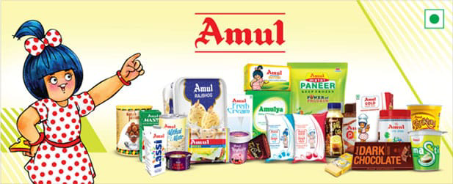
Buyer's /Audience persona

Slide 12
The target Audience for Amul brand can be defines as follows.
1. Age group
2.Demographics
3.psychogrpahics
4.behaviour
5.Interest

Slide 13
The target Audience for Amul brand can be define as follows.
1.Age group: Examples of age groups include children (0-12 years), teenagers (13-19 years), young adults (20-39 years), adults (40-64 years), and seniors (65 years and above). Age groups are often used for statistical analysis, targeting specific demographics, or creating age-appropriate content and services.
2.Demographic:
Gender: In recent years, AMUL has been making efforts to empower women in the dairy sector by providing training, resources, and support.
income:In 2019-2020, AMUL's turnover was reported to be around INR 44,000 crore (approximately USD 6.1 billion).
3.psychographics:
life style: it has significantly impacted the daily lifestyle and food habits of millions of India

Slide 14
4. Behavior:
purchase pattern: Regular consumers of this products ,particularly interested in high quality .
Brand loyalty: Building strong and loyalty through innovative and budget friendly.
5.Interest:
Quality and performances: consumers who priorities product performance and budget friendly.

Slide 15
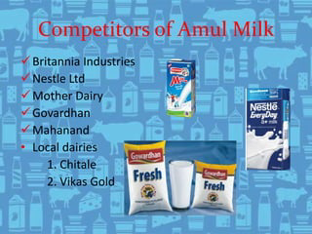
Competitor analysis

Slide 16
Competitor-1: Hap
USP:
Improved physical health: Happy people tend to have stronger immune systems, lower blood pressure, and better overall health.
Enhanced mental well-being: Happiness reduces stress and anxiety, leading tobettermental health and a more positive outlook on life.
online communication:
Share uplifting content:Post or share inspirational quotes, funny jokes, or heartwarming stories that can brighten someone's day.
Be kind and supportive: Encourage and uplift others by offering words of kindness, empathy, and support. .

Slide 17
Swot analysis
Strengths:
Positive emotions: Happiness is associated with positive emotions, such as joy, contentment, and satisfaction, which can improve overall well-being.
Weaknesses:
Subjective nature: Happiness can be subjective and may vary from person to person, making it challenging to measure or quantify.
Opportunities:
Mental health awareness: The growing awareness of mental health issues presents an opportunity to promote happiness as a means to improve overall well-being and R resilience
.Threats:
Social media comparison: The use of social media can lead to unrealistic expectations and feelings of inadequacy, potentially undermining happiness.

Slide 18
Competitor 2 : milky mist
Usp :Aesthetics: Milky mist can create a visually appealing atmosphere, especially in settings like gardens, parks, or events where a dreamy, ethereal ambiance is desired.
Humidification: In certain environments, such as greenhouses or indoor gardens, a milky mist can help maintain the proper humidity levels, promoting healthy plant growth.
Online communication : It seems like you are referring to the term "milky mist" in the context of online communication. However, it is not a well-known phrase, and I would need more context to provide a clearer understanding.
.

Slide 19
Strengths:
Unique product: Milkly Mist is a unique product that offers a different experience compared to traditional milk tea or bubble tea.
Weaknesses:
Limited market presence: Milkly Mist may not have a strong presence in the market, making it challenging to compete with established milk tea brands.
Opportunities:
Growing health-conscious market: As more consumers prioritize health and wellness, Milkly Mist could benefit from the increasing demand for healthier beverage option SThreats:
threats:
Competition from established brands: Milkly Mist may face stiff competition from well-established milk tea brands with a strong market presence.

Slide 20
competitor 3 : Hershey
Usp :Taste: Hershey's chocolates are known for their rich, smooth, and delicious taste, which has made them a favorite for many people around the world.
Variety: Hershey's offers a wide range of products, including different types of chocolate bars, kisses, baking products, and seasonal treats, catering to various tastes and preferences.
Online communication:Official website: Hershey's has an informative and visually appealing website (www.hersheys.com) where they share information about their products, company history, and initiatives.

Slide 21
Strengths:
Brand recognition: Hershey's is a well-known and trusted brand with a strong reputation.
Weaknesses
Limited intence: Compared to other chocolate brands, Hershey's has a relatively smaller international footprint, limiting their growth potential.
Opportunities:
Expansion into new markets: Hershey's can explore opportunities to grow their international presence and tap into new consumer bases.
Threats:
Competition: Hershey's faces competition from other chocolate brands, as well as non-chocolate snack manufacturers, which could impact market share.

Slide 22
part-2 : SEO & Keyword Research

Slide 23

SEO Audit

Slide 24
on page optimization

Slide 25
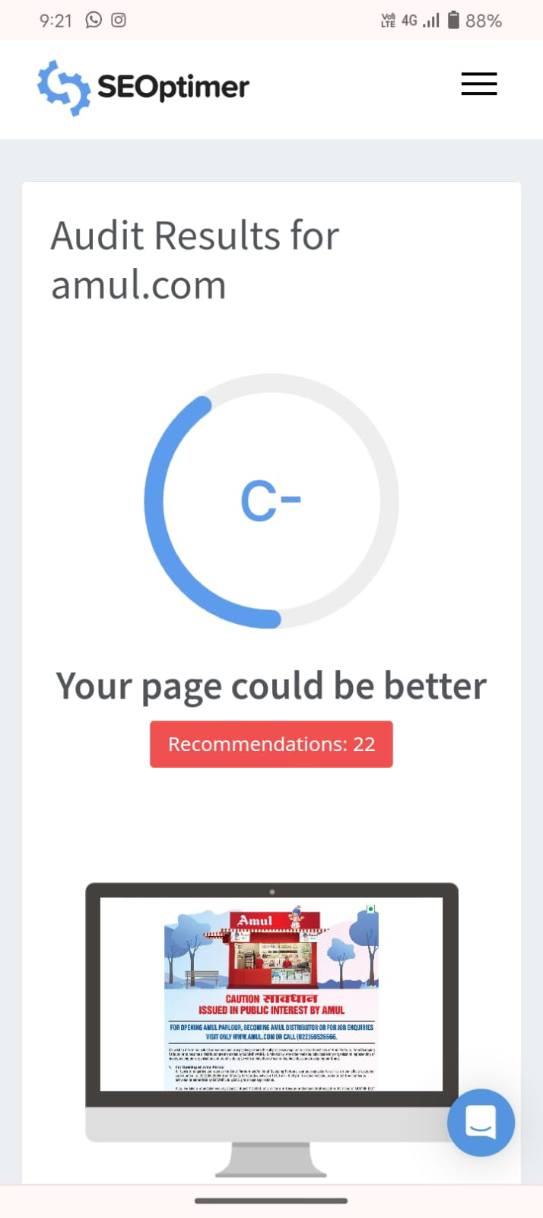

Slide 26
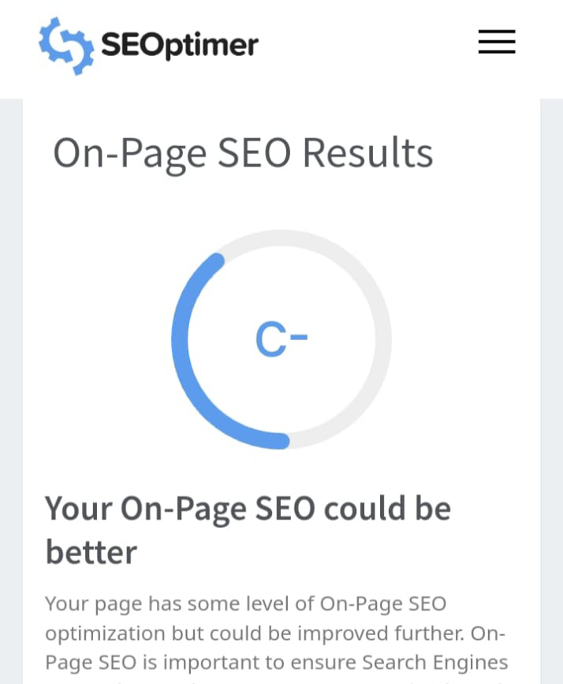

Slide 27
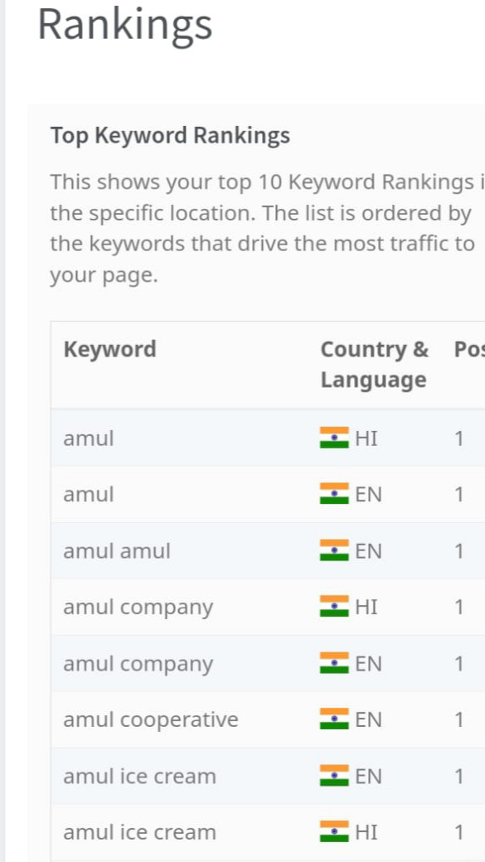
Rankings

Slide 28
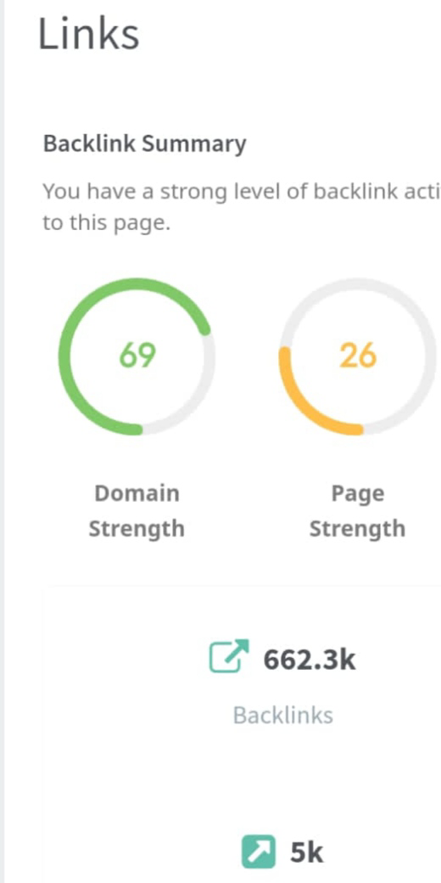
Links

Slide 29
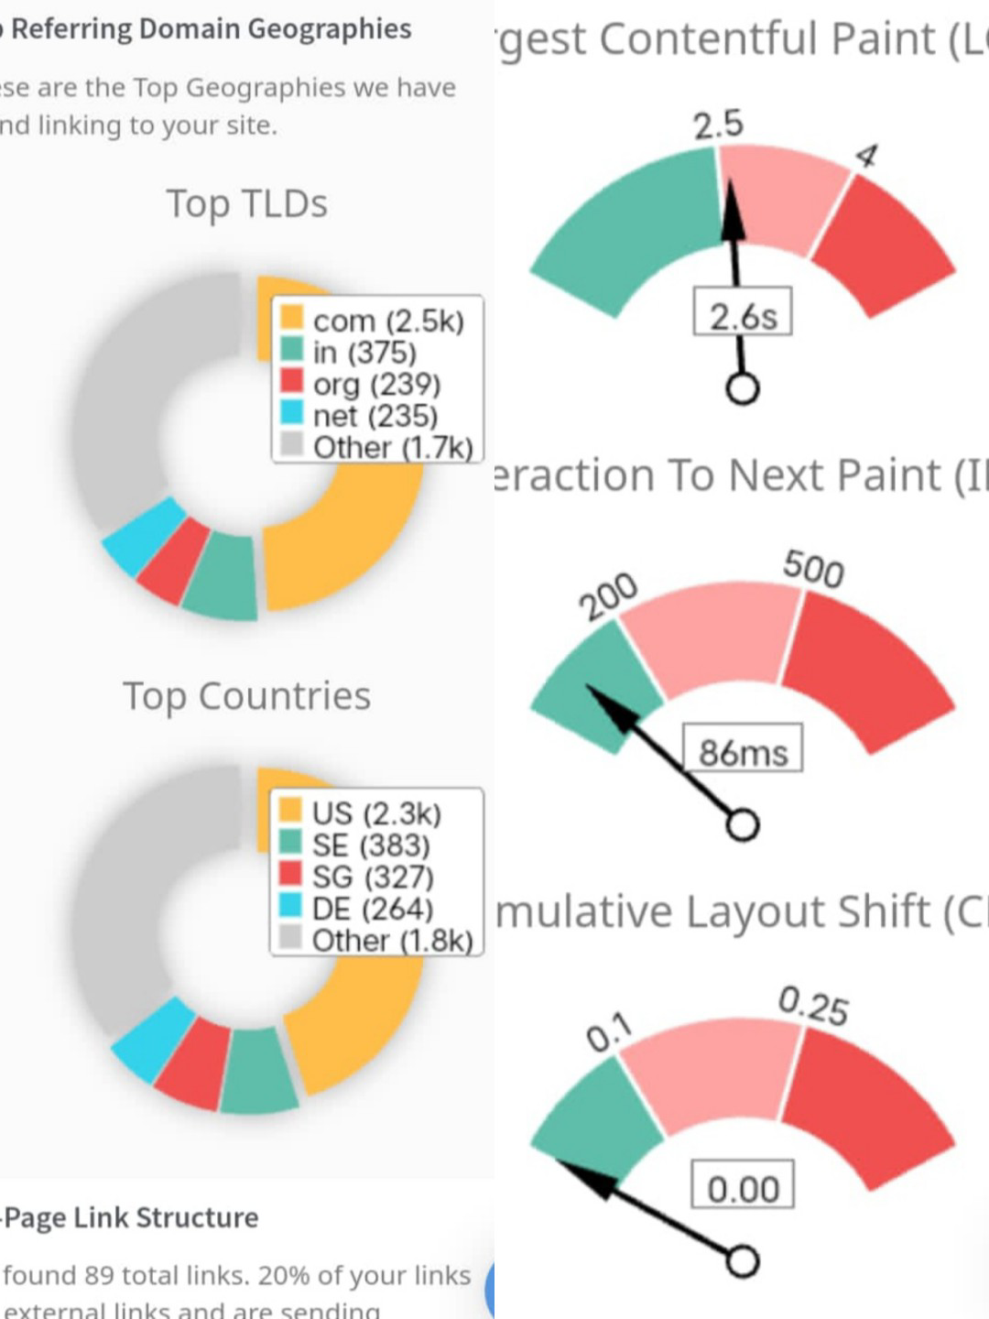

Slide 30
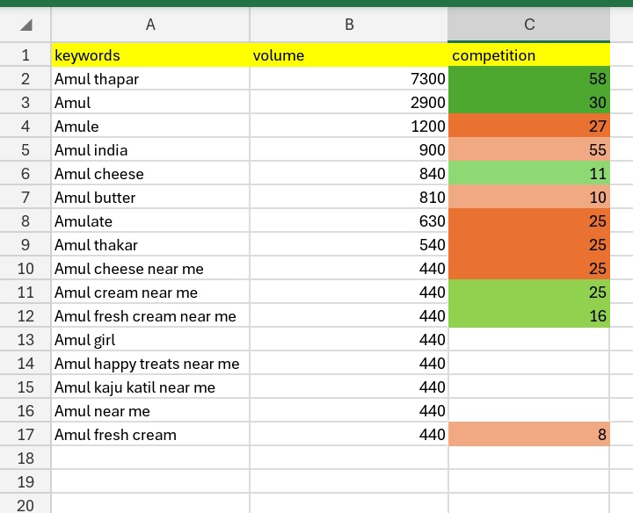
Keyword Research

Slide 31
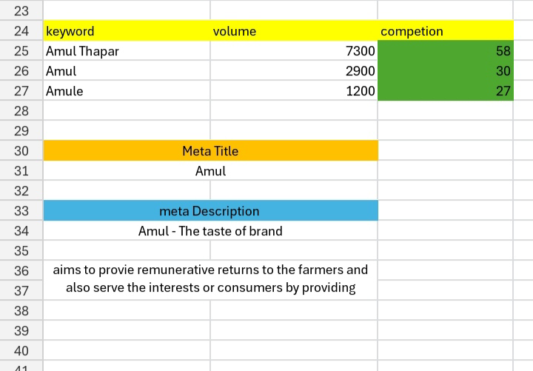
on page optimization

Slide 32
content optimization
challenges faced and insights gained from keyword research
Competition: AMUL competes with numerous other dairy brands in India, both local and multinational, which puts pressure on pricing, product quality, and marketing strategies.
Consumer preferences: As consumers become more health-conscious and environmentally aware, AMUL needs to adapt its product offerings to cater to these changing prefer
Supply chain management: Managing a vast network of farmers and processing units can be a significant challenge for AMUL. Ensuring the quality and consistency of milk supply, as well as maintaining efficient distribution channels, is crucial for the brand's success.
Regulatory environment: The Indian dairy industry is heavily regulated, with various governmecC challenging ane guidelines affecting the operations of dairy cooperatives like AMUSupply chain management: Managing a vast network of farmers and processing units can be a significant challenge for AMUL

Slide 33
Key insights :
Cooperative model: AMUL's cooperative structure allows it to harness the collective strength of a large number of milk producers, ensuring a steady supply of high-quality milk.
Strong brand identity: AMUL has built a strong and recognizable brand identity through its "Utterly Butterly Delicious" slogan, distinctive logo, and effective advertising campaigns.
Product diversification: AMUL offers a wide range of dairy products, catering to various consumer preferences and needs.
Quality control: AMUL maintains strict quality control measures throughout its supply chain, from milk collection to product manufacturing and distribution. This focus on quality has earned the brand a reputation for reliability and safety, which is essential in the dairy industry.

Slide 34
part - 3: content idea and marketing strategies

Slide 35
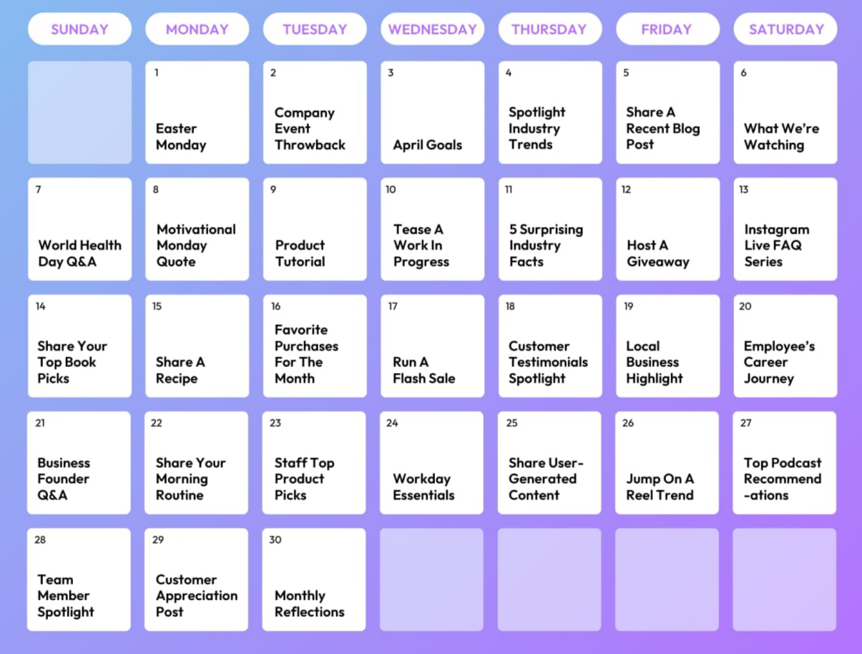
content calendar

Slide 36
content ideas :
The History and Evolution of AMUL: Delve into the brand's origins, its journey from a small-scale cooperative to a household name in India, and how it has evolved over the years to adapt to changing market conditions and consumer preferences.
AMUL's Cooperative Model: Explore the unique cooperative structure that underpins AMUL's operations, highlighting how it empowers milk producers, fosters a sense of ownership, and contributes to the brand's successful.
content strategies :
Content Creation: Develop high-quality, engaging, and informative content that showcases AMUL's brand values, products, and achievements. This can include blog posts, articles, infographics, videos, and social media posts.
Consistent Brand Messaging: Ensure that all content aligns with AMUL's brand identity, tone, and values, maintaining a consistent voice and image across all platforms.

Slide 37
part-4 : Content creation and curation

Slide 38
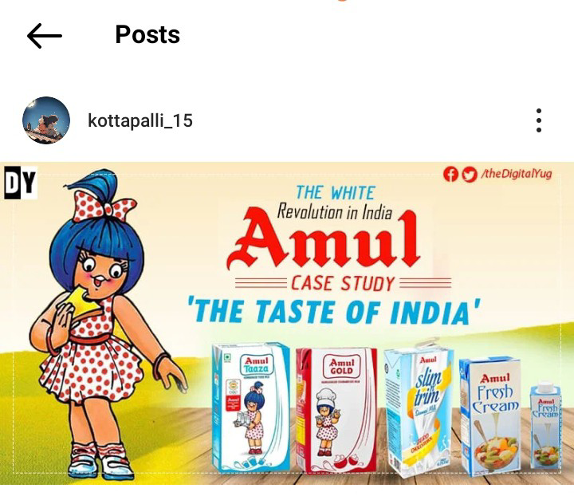
Formate-1 : Static post on Amul
Caption: The Taste of india

Slide 39
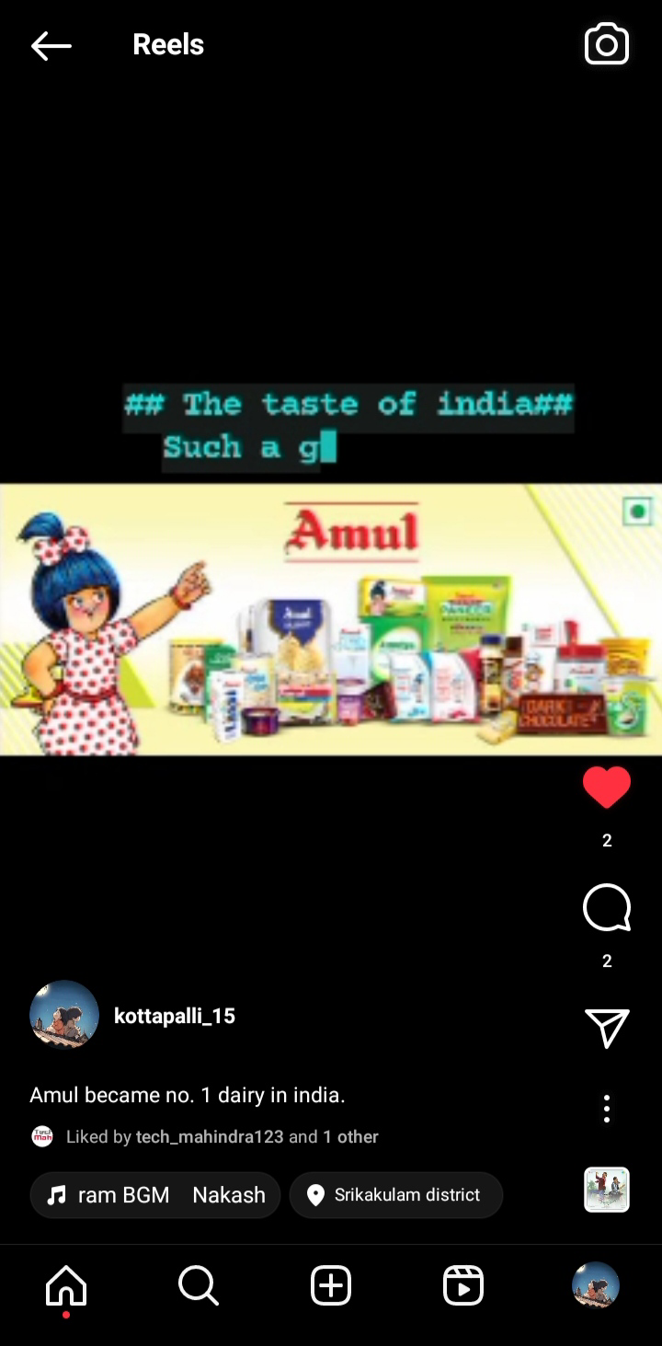
Formate-2: Post Reel on AMUL
Caption: Amul became no.1 dairy in india.
Hashtags: The Taste of india. such a good product.

Slide 40
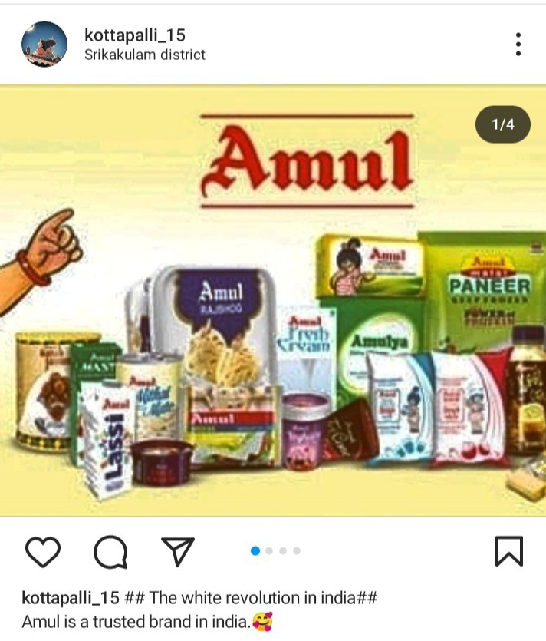
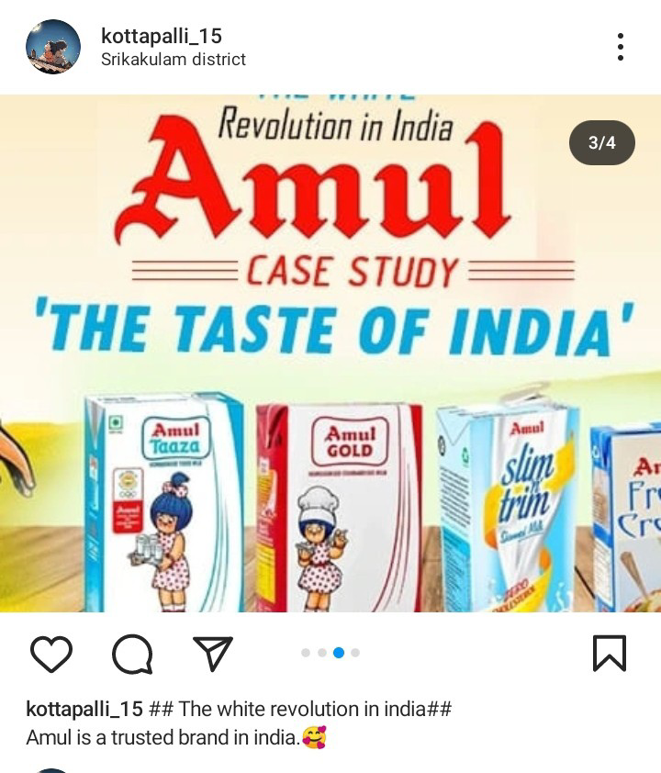
Formate-3: coursel post on Amul
caption: The white revolution in india. Amul is a trusted brand in india.

Slide 41
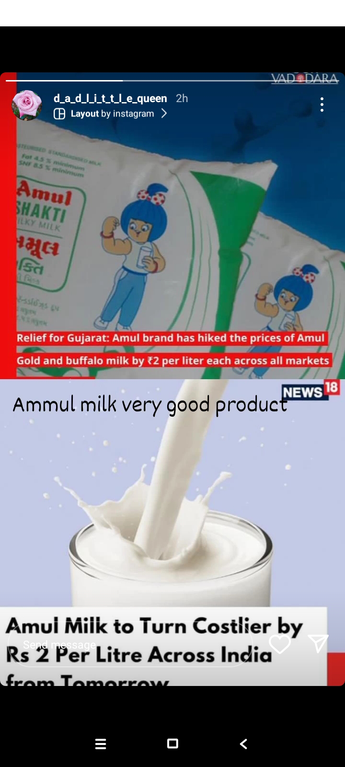
INSTAGRAM STORY
link for insta reel: https://www.instagram.com/reel/C52f-TTLNwI/?igsh=MnVvbmo4Z3IyYnhw
links for insta story :
https://www.instagram.com/s/aGlnaGxpZ2h0OjE3OTcwNzkyMjcyNzA0NDMy?story_media_id=3348005769385403765_61881455301&igsh=aGljbTcyaGQ0eWw=%20%C2%A0

Slide 42

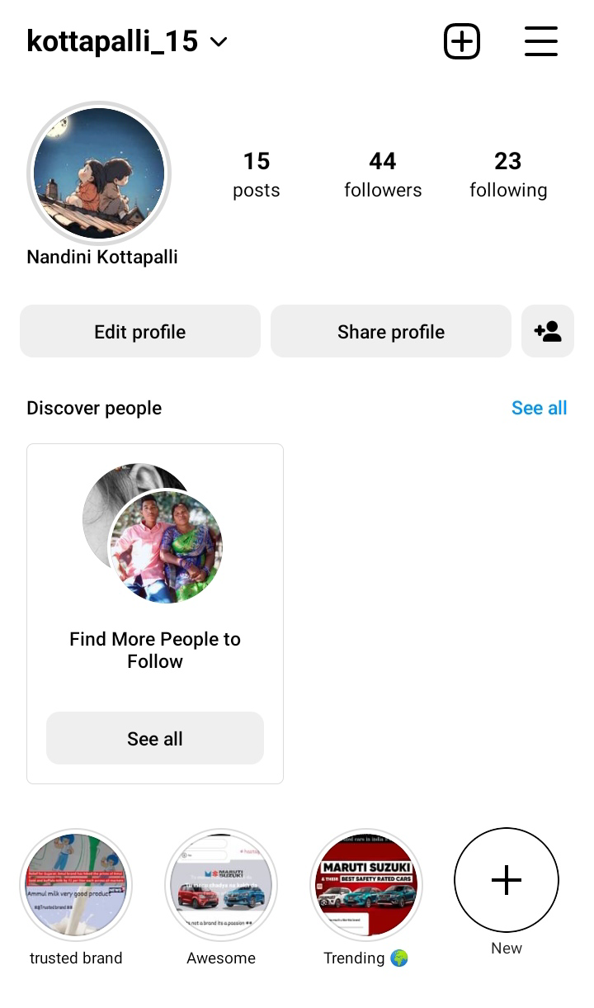
Highlight of instagram

Slide 43
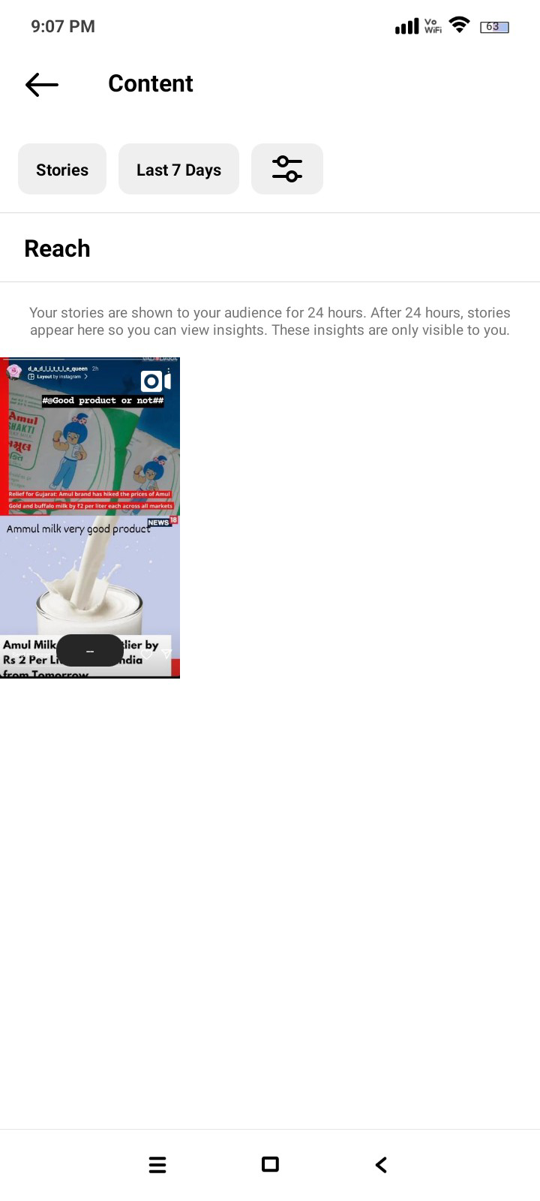
Story insights- Q&A
Reached: 5
impressions: 3
comments: 4
Area of improvement:
1.story could be Better
2.since the shares of informative stories are more,we could create more information stories.

Slide 44
Designs / video Editing
In this we use the zoho app and gap cut and use the picture arts app for photos editing.
Thank you

